Slide 1


Limited-memory assembly free finite element simulation of fused deposition modeling process
Aaditya Chandrasekhar
Graduate Student , Mechanical Engineering
Behzad Rankouhi
Graduate Student , Mechanical Engineering
Krishnan Suresh
Professor
July 2017 – Montreal, CA

Slide 2
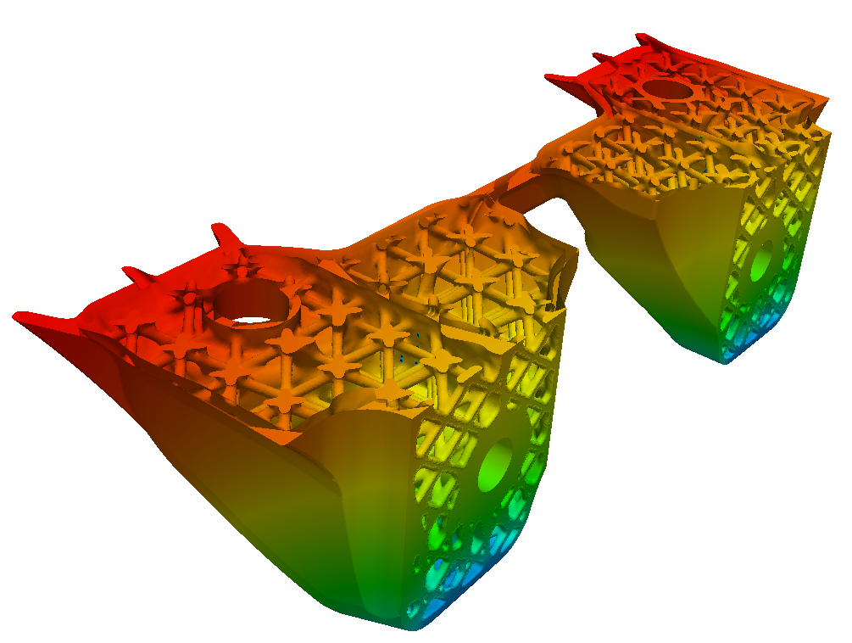
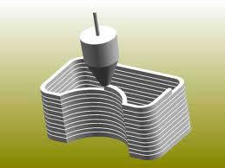
Overview
Why AM ?
Simulation of AM ?
Challenges in AM Simulation
Assembly Free AM Simulation
Case Study
Future Work and Challenges

Slide 3
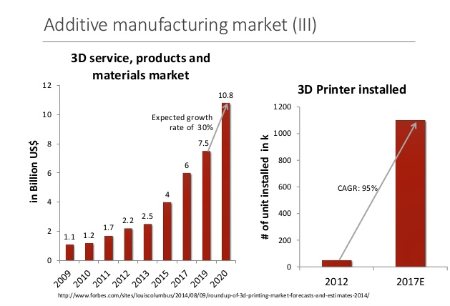
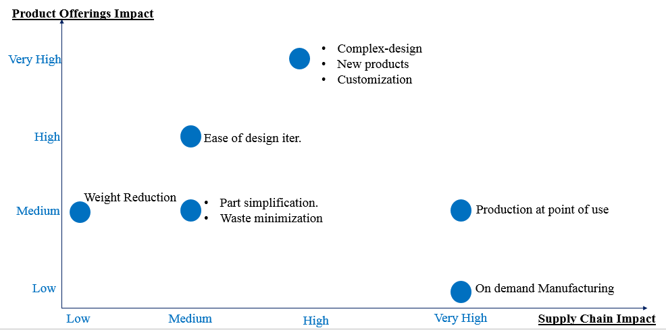
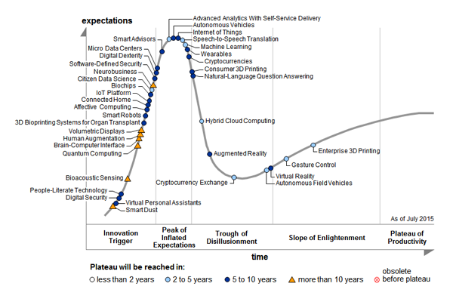
Why AM ?

Slide 4
AM – Current status
Still majorly a prototyping tool rather than part production.
Suffers from low print reliability (no standards as of now ) and low print repeatability.
Part defects at various scales.
“To increase the penetration from today’s point of view, the current, most relevant success factors across the analyzed industries are the following A) Design rules B) Surface quality C) Process reliability and part reproducibility”
- D.O.E, Technology Assessment ,2015
“The distortion and residual stresses resulting from … severely degrade the dimensional accuracy and mechanical performance of components, but also increase the manufacturing cost …”
-Jun Cao et al., Journal of Materials Processing Technology, November 2016

Slide 5
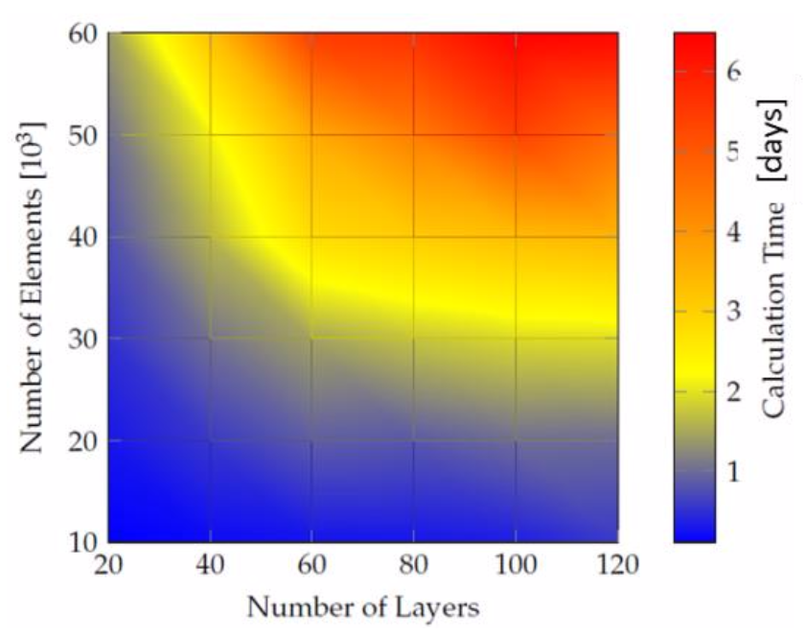
Current status of AM Simulation
Expected calculation times for conventional thermo-mechanical simulations of AM process
Time scale in days for each simulation!
N Keller , SFF Symposium 2014

Slide 6
Simulation of AM
Identify relevant physics
Discretization
Errors
Numerical methods
Experiments
Simulation Results

Slide 7
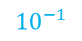
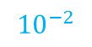
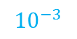
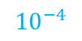
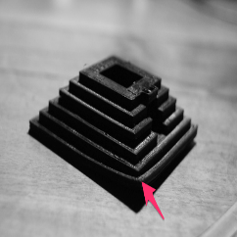
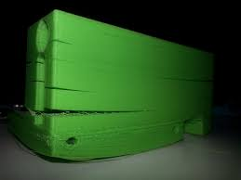
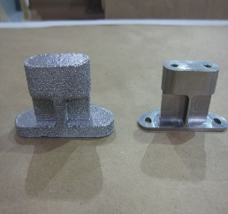
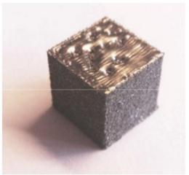
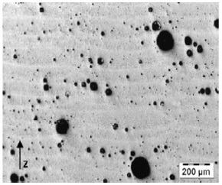
Part Defects
~ Part
~ Layer
~ Printer Resolution
~ Melt Pool
~Keyhole
Size (mm)
1
Feature Size
Defects
Warping
Delamination
Surface Finish
Swelling
Pores and voids
Current Study
Future Work …

Slide 8
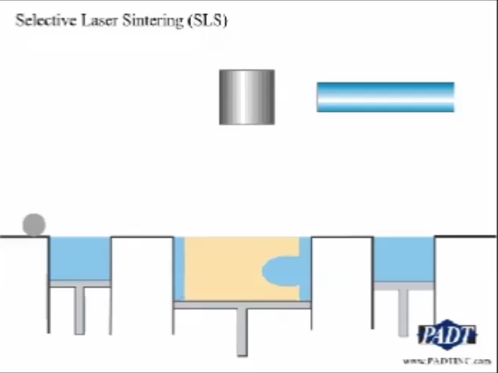
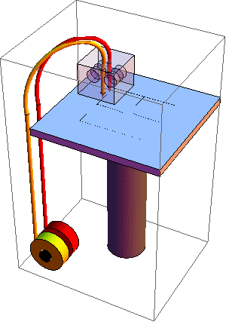
Relevant Physics
Laser Abs.
Melt pool
Melting
Viscous flow
Solidification
Interlayer bonding
Residual stress
Particle Dyn.
Heat Transf.
Fused Deposition Modeling
Selective Laser Sintering

Slide 9
Relevant Physics
Defects | Scale (mm) | Physics/ Modeling Challenges
Warping | ~10 - 1 | Viscous Flow Heat Transfer Bonding mechanisms Solidification Residual stress
Delamination | ~1 - 0.1 | Bonding Mechanisms Residual Stress
Surface Finish |  | Stochastic Deposition models Melt pool characteristics
Swelling |  | Surface Tension Residual stress and shrinkage
Voids and Gas Pores |  | Powder surface chemistry Key-hole effects
High cooling rate
Models for Bonding mechanisms

Slide 10
Simulation of AM
Identify relevant physics
Discretization
Errors
Numerical methods
Experiments
Simulation Results

Slide 11
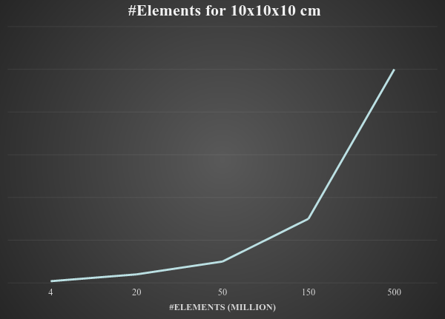
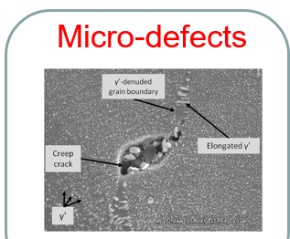
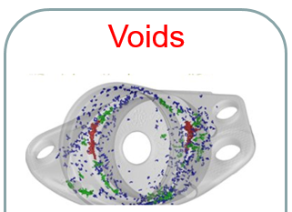
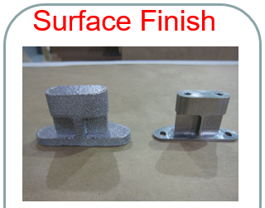
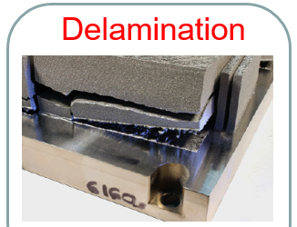
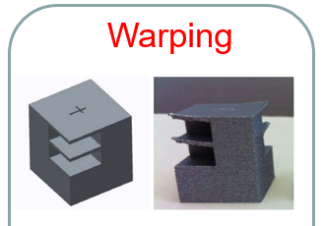
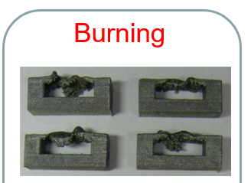
Mesh Resolution

Slide 12
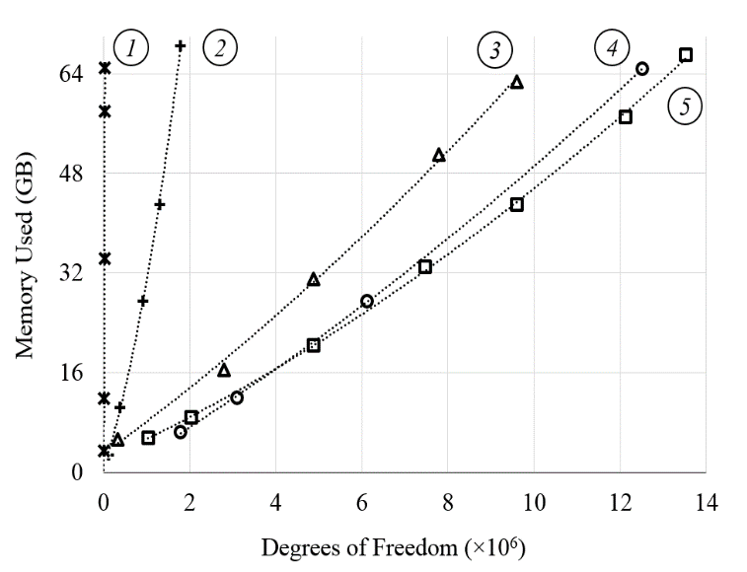
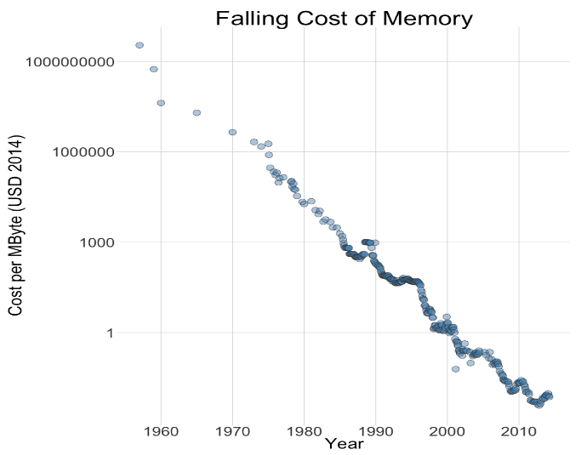
‘Cheap’ But ‘Expensive’
Source COMSOL
Notes:
Even though memory cost has been reducing we are simulating more and more #DOF system.
Case 1: A heat transfer problem of a spherical shell. There is radiative heat transfer between all of the surfaces. The model is solved with the default iterative solver.
Case 2: A structural mechanics problem of a cantilevered beam, solved with the default direct solver.
Case 3: A wave electromagnetics problem solved with the default iterative solver.
Case 4: The same structural mechanics problem as Case 2, but using an iterative solver.
Case 5: A heat transfer problem of a block of material. Only conductive heat transfer is considered. The model is solved with the default iterative solver.

Slide 13
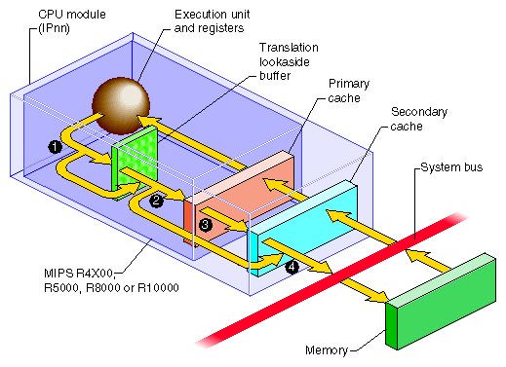
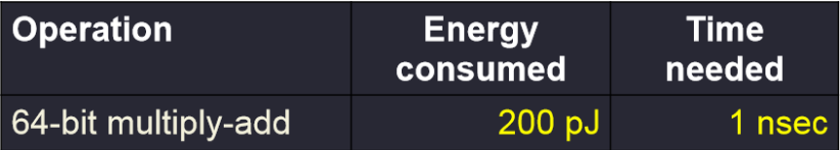
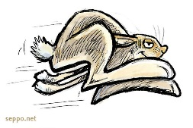

Memory Bottleneck
Memory access speed haven’t kept up with CPU speed.
[“The End of Error: Unum Computing”, Gustafson, CRC Press,2015]
Memory access is about 70 times slower!
Courtesy of IRIX® Device Driver Programmer's Guide
REDUCE MEMORY SIZE

Slide 14
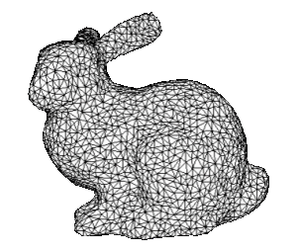
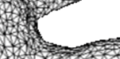
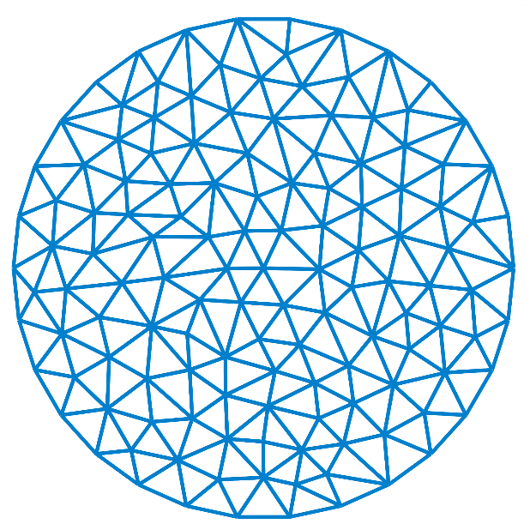
Traditional Approach
Every element is different
Large amount of storage
Better conformity
Finite element Mesh
Assembly of stiffness Matrix

Slide 15


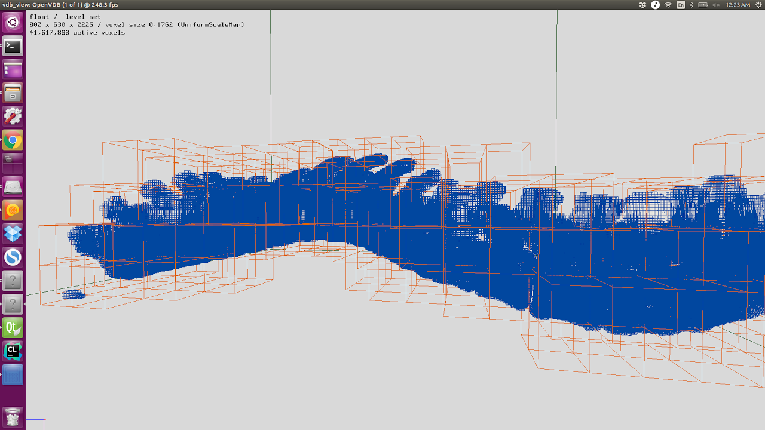
voxel mesh framework
Introduced by the gaming and graphics industry.
Common theme
Virtually infinite domain
High resolution
Low storage
Suited for sparse tree structures
Challenges - voxel mesh for FEA
Low conformity
Lower order continuity
All elements congruent
41,617,893 voxels !

Slide 16
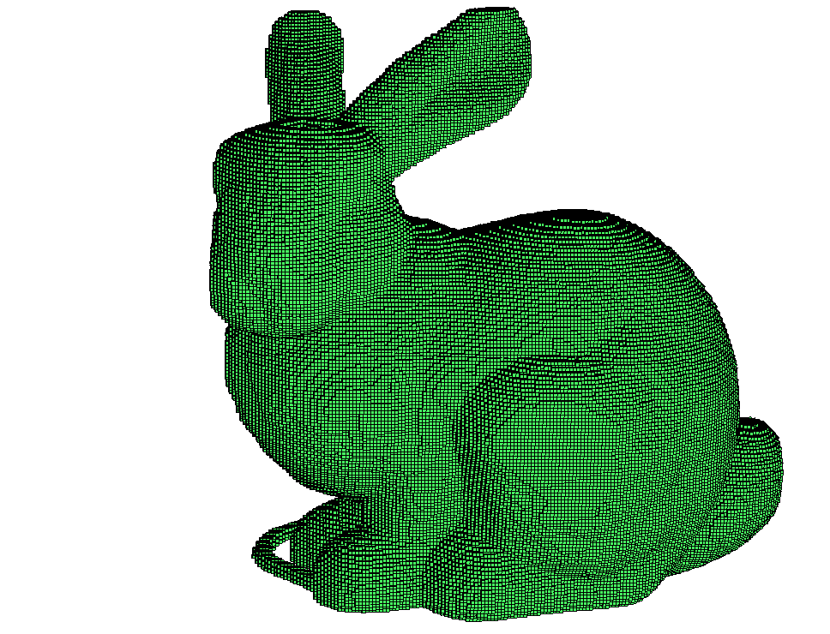

Voxel Mesh
Voxels are congruent to one another.
Storage: Gigabytes Kilobytes !
Greatly reduce memory access
Concept developed in the 1980’s

Slide 17
Computational Modeling of Material Deposition
Method | Feature
Remeshing | Local Mesh Refinement High Accuracy Expensive Remeshing
Quiet Element | One time Meshing Ill-Conditioned Error from spurious elements Large system
Inactive Element | Expensive Repeated solution initialization
Hard-Kill Element | One time Meshing High Mesh Resolution at negligent cost Well – conditioned system

Slide 18
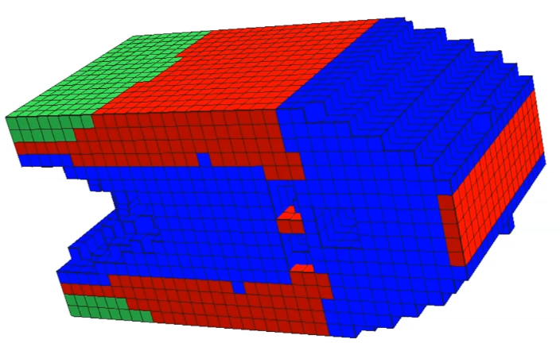
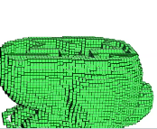
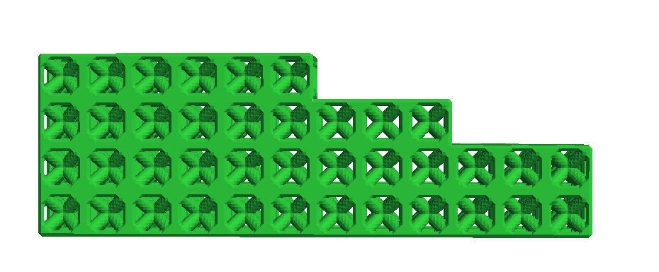
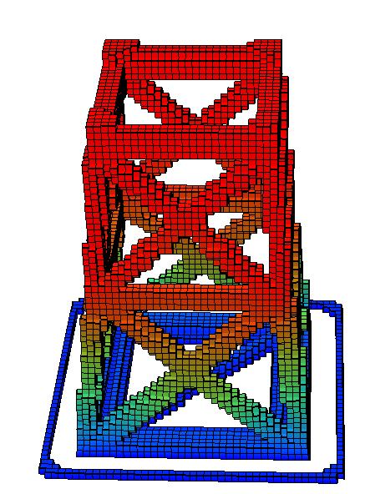
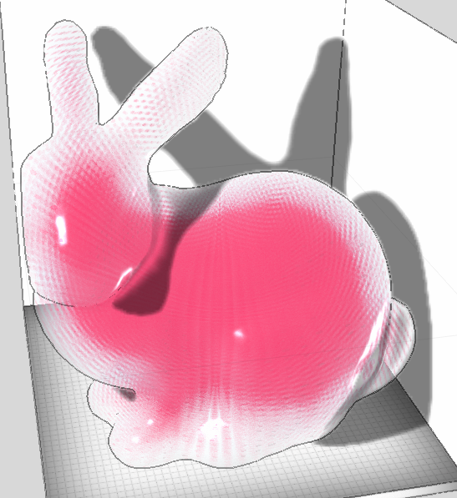
Voxel mesh for AM
Microstructure
Slicing
Multi –Material
VOXEL MESH
Geometry Representation
FEA Simulation
Geometry Create/Edit

Slide 19
Simulation of AM
Identify relevant physics
Discretization
Errors
Numerical methods
Experiments
Simulation Results

Slide 20
Numerical Methods
Assembly Free Solver
Material Nonlinearity
Deflation

Slide 21
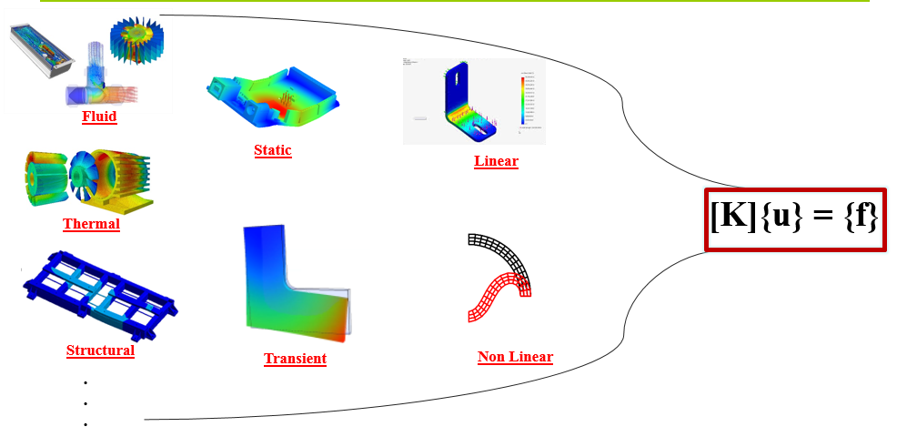
Understanding the throttle

Slide 22
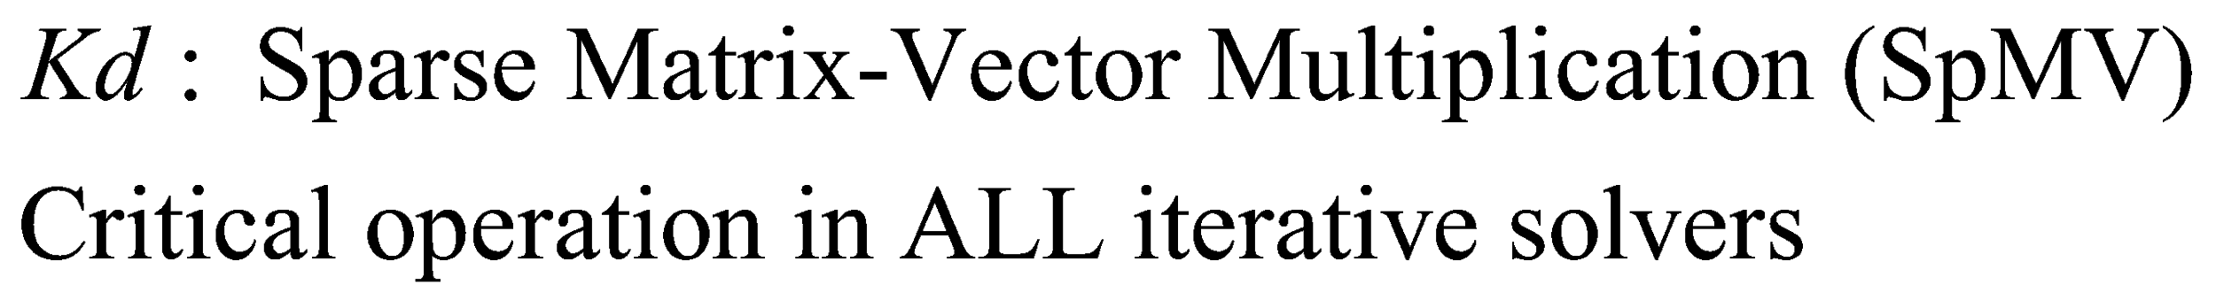
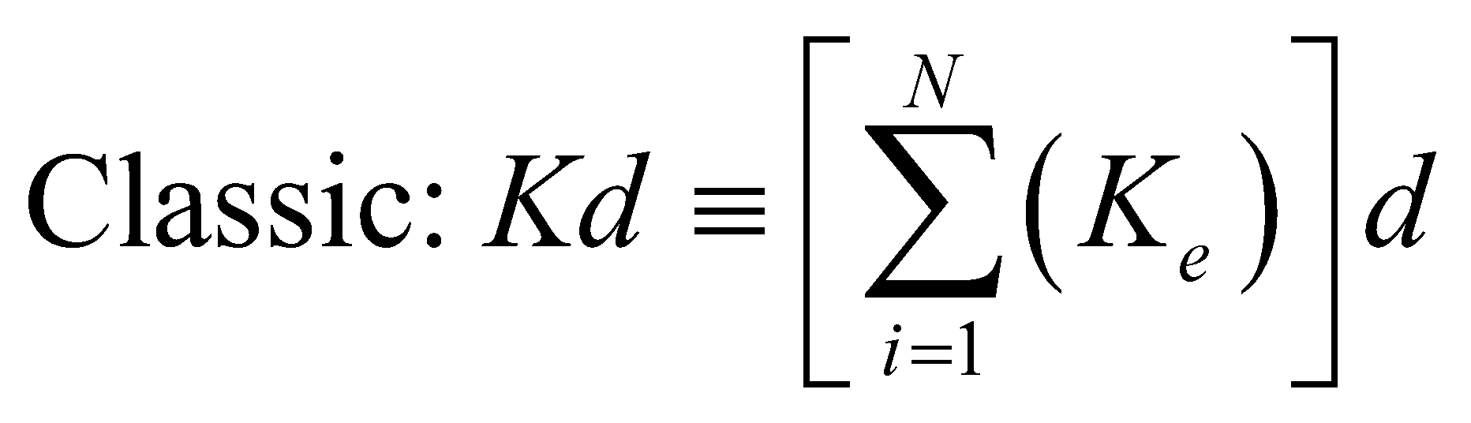
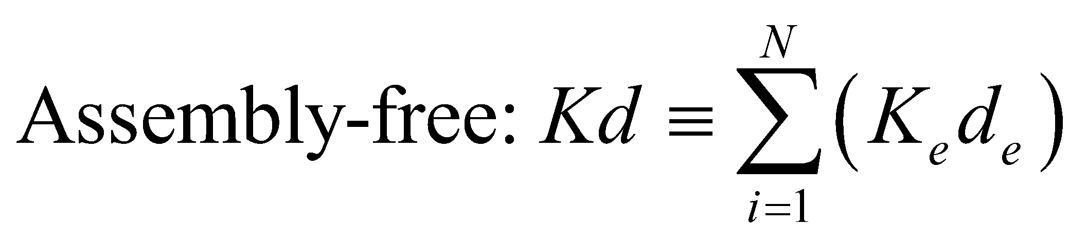
Implication: SpMV
Only store K_{e} of distinct elements + Assembly Free

Slide 23
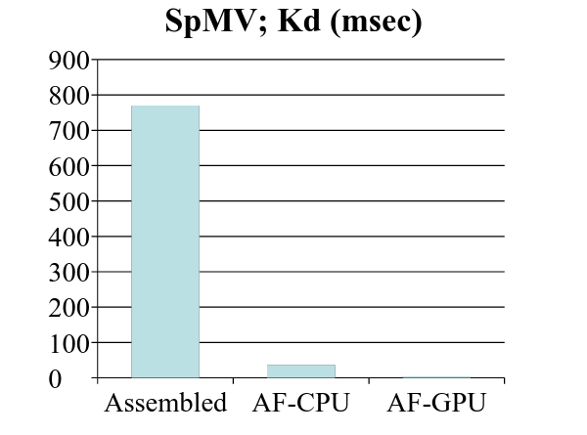
Experiment
Assembled Kd
770
Asssembly-Free Kd
37
1 million DOF (Kd, SpMV)
Same number of FLOPS!
Reduced memory access time

Slide 24
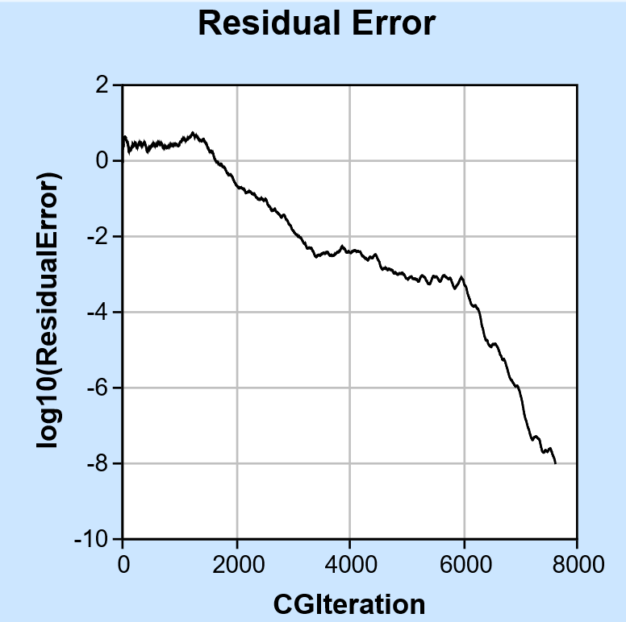
Challenge
[K]{u} = {f}
Slow convergence of CG without a preconditioner
Preconditioner without assembling K?

Slide 25
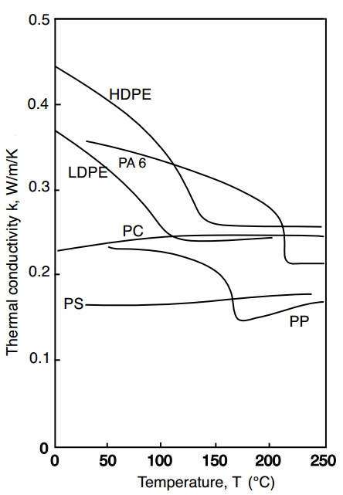
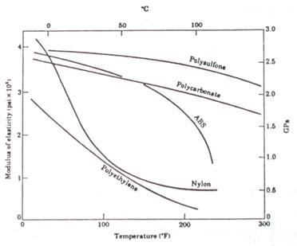
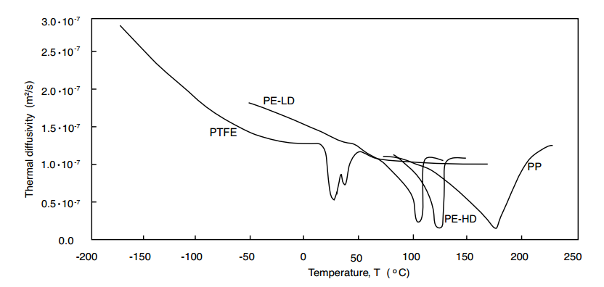
Material behavior
Material nonlinearity :
Iterative solver
Behavioral congruence of voxels lost

Slide 26

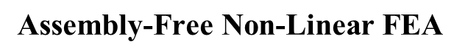
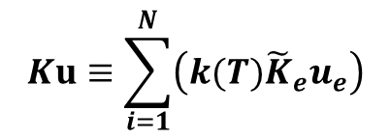



Non Linearity
Thermal conductivity Coeff.
Depends on Current Temperature
Newton Raphson Method :
Jacobian similar to [K]
Assembly Free!
No extra computation!

Slide 27


Deflation
Slower convergence of CG
Accelerate convergence
Preconditioners ?
Deflation ?
Multi – grid techniques ?
Agglomeration into groups for physics based deflation
Multi- grid cycles

Slide 28



Deflation

Slide 29

Assembly-Free Deflation
Accelerate CG without assembling K!
40 times faster convergence!
Mirzendehdel, A. M., Suresh, K., “A Deflated Assembly Free Approach to Large-Scale Implicit Structural Dynamics,” J. Comput. Nonlinear Dynam., 10(6), doi: 10.1115/1.4029110, 2015

Slide 30
Challenge in Deflation
Scale to large scale FEA ?
Cost of computing W’KW ?
Multi- grid technique ?

Slide 31



Case Study

Slide 32
Identify relevant physics
Discretization
Errors
Numerical methods
???
Experiments
Simulation Results

Slide 33
Laser Polishing Example

Slide 34






Warping
Thermal Stresses due to rapid solidification.
Part distortion
Bad junctions between supports and components
Poor part quality and reliability
Large temperature gradients
Warping and breakage/delamination

Slide 35
Conclusion

Slide 36


Future Work
Integrate with commercially developed open-source voxel frameworks.
Develop Multi-grid solvers for large scale FEA.
Simulate Powder-bed fusion process.
GVDB from NVidia
OpenVDB from DreamWorks

Slide 37
100 Million voxels at play
Insert Video showing deposition of 100 Million voxels ( OpenVDB Framework )
In a bunny model.

Slide 38
A multi material example
Show video of a local control of material deposition with a voxel based framework

Slide 39
Microstructure
Motivation from Bio-Mechanics
Images of Voronoi cells and other foam like structures – File size and access time comparison with volume of mesh error ( graph )

Slide 40
Thank you!
Questions?

Slide 41
APRA-E Project
Fiber Analysis
gCode Optimization and Customization

Slide 42




Fiber Analysis
Obj: Maximize HX thermal conductivity
?
Orientation ?
Fill Ratio ?

Slide 43


Finite Element Analysis
Fill Ratio
Material Prop.
Geom. Distribution
Design Exploration

